Slide 1
FEEDBACK MANAGEMENT SYSTEM
Using OOP concepts

Slide 2

BY: AFNAN KHAN 406338 & HIRA ZAHID 429142

Slide 3
An object oriented C++ Program which stores and maintains course feedback provided by students.

Slide 4

BRIEF
The program is designed to store and maintain data about feedbacks provided by students about courses offered by a university/educational institution. The feedback consists of various questions about the course, its content, efficiency of teaching methods, and so on.

Slide 5
WORK DISTRIBUTION-1
Admin.h/cpp
Caesar Cipher Algorithm
Afnan
Project Proposal
Admin files
Coding(Header/Implementation)
GUI

Slide 6
WORK DISTRIBUTION-2
Feedback.cpp
Independent_Functions.h/cpp
Hira
Student.h/cpp
Presentation
Driver file
Header and Implementation File
Student Header and Implementation

Slide 7
CODE FUNCTIONALITIES

Slide 8

ADMIN
Login to the system using your Username/Password
Admin can manage feedback form:
View The Feedback form
Add a new Question
Remove an existing Question
Search in the feedback form
Admin can manage the students:
Check total number of Students
Search for a Student
Remove a Student
Add a New Student

Slide 9
ADMIN (CONTINUED)
Admin can manage feedback submitted by students:
Check Total Number of feedbacks submitted
Print a submitted feedback
Remove a submitted feedback
Admin can change his/her password

Slide 10
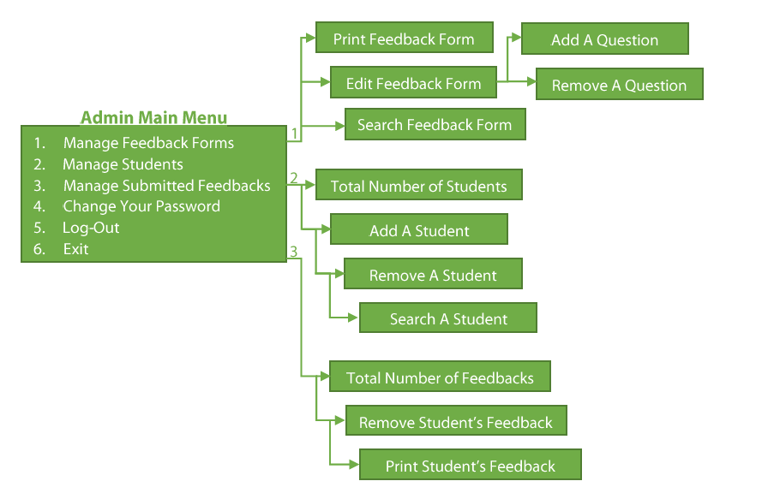
ADMIN

Slide 11

STUDENT
Login to the system using username and password
View the feedback form
Fill out the feedback form
View his/her submitted feedback
Change his/her password

Slide 12
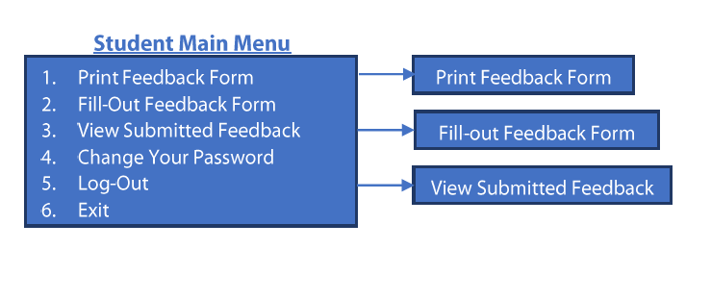
STUDENT

Slide 13
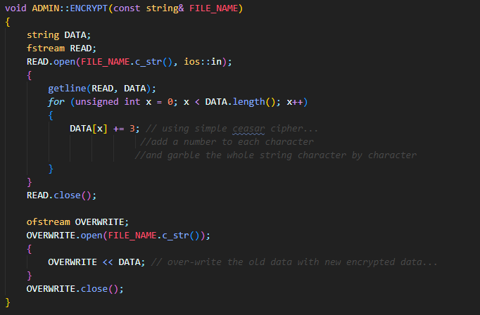
ENCRYPTION

Slide 14
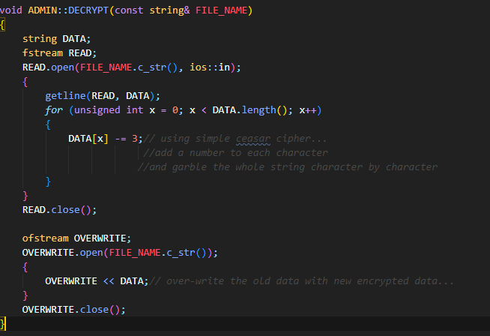
DECRYPTION

Slide 15
OOP CONCEPTS COVERED
Classes
Objects
Member Functions
Exception Handling
Setters & Getters
Inheritance
Encapsulation

Slide 16
OOP CONCEPTS COVERED
Polymorphism
File Handling
Dynamic Memory Management
Abstract Classes
Pure Virtual Functions
STL

Slide 17
CLASSES
Encryption
Decryption
Admin
Student

Slide 18
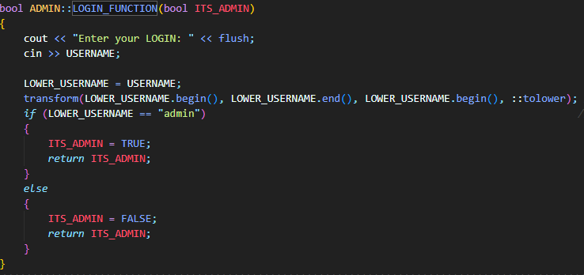
MEMBER FUNCTIONS(SOME EXAMPLES)

Slide 19
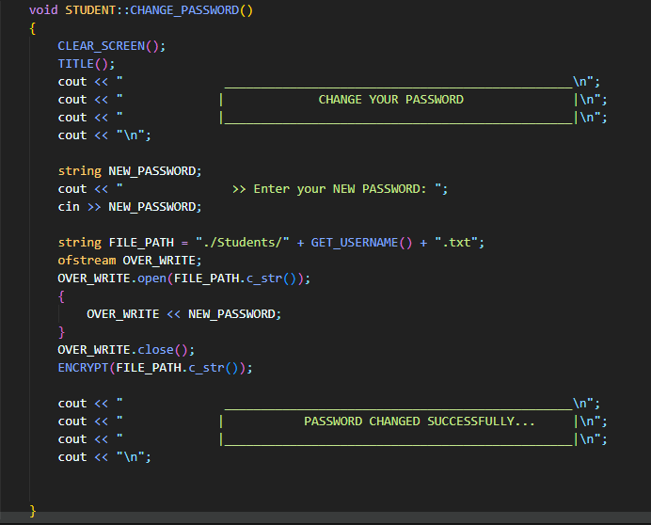
MEMBER FUNCTIONS(SOME EXAMPLES)

Slide 20
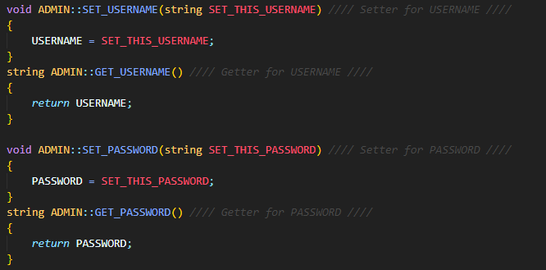
SETTERS AND GETTERS

Slide 21
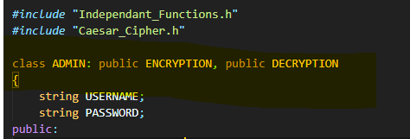
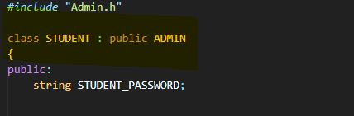
INHERITANCE

Slide 22
REVISITING CLASSES
Encryption
Decryption
Admin
Student
This shows multiple and multilevel inheritance

Slide 23
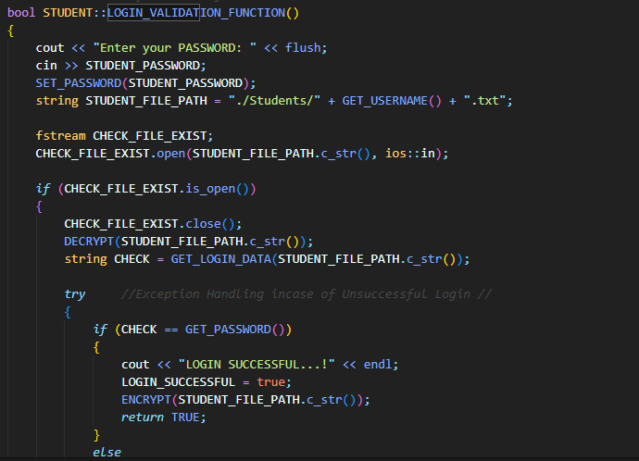
POLYMORPHISM
Static Polymorphism

Slide 24
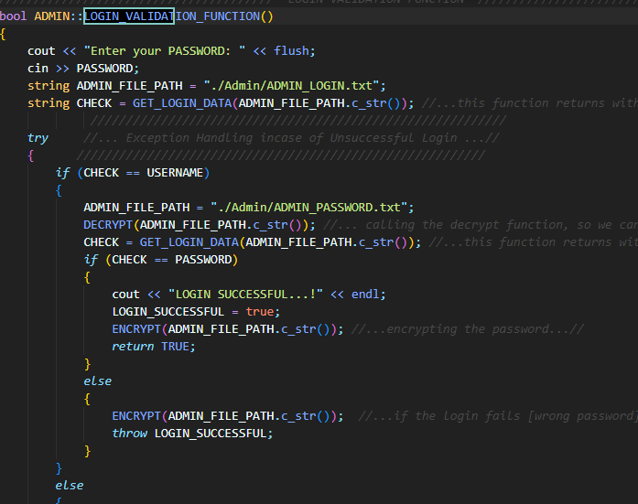
POLYMORPHISM
Static Polymorphism

Slide 25
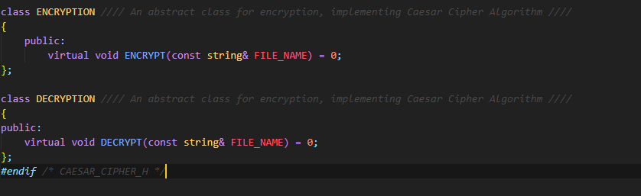
PURE VIRTUAL FUNCTIONS AND ABSTRACT CLASSES
Dynamic Polymorphism

Slide 26
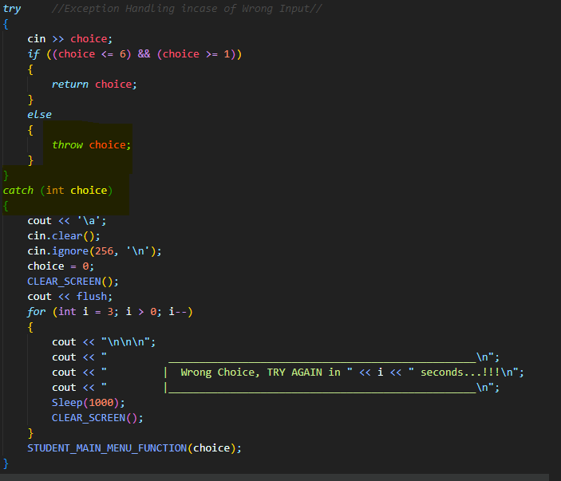
EXCEPTION HANDLING

Slide 27
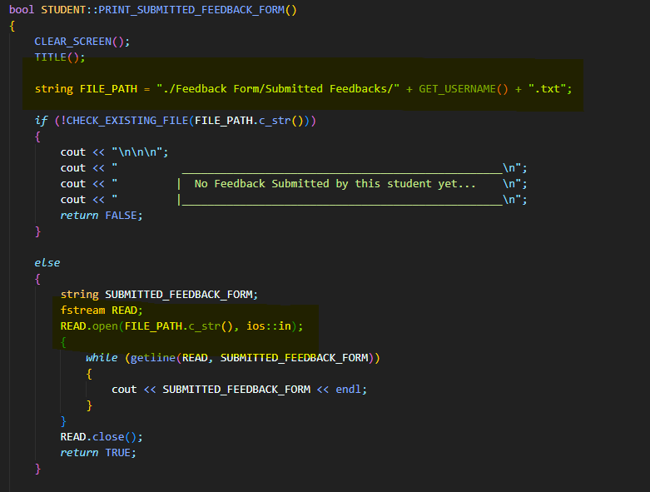
FILE HANDLING

Slide 28
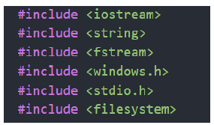
STL
Here string, fstream and filesystem are Standard Template Library

Slide 29
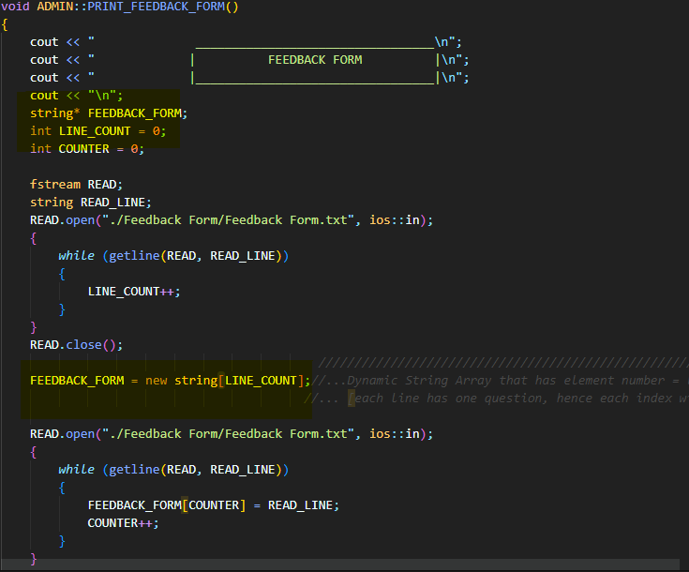
DYNAMIC MEMORY MANAGEMENT

Slide 30
FUNCTIONS

Slide 31
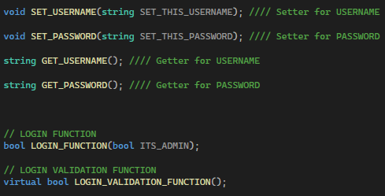
ADMIN FUNCTIONS

Slide 32
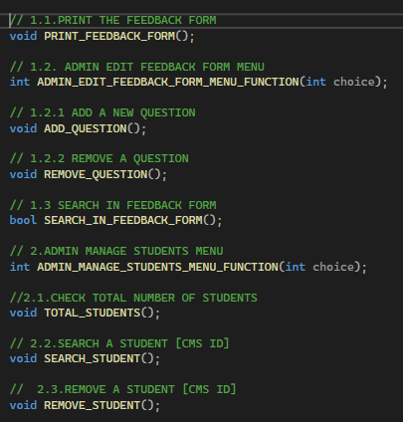
ADMIN FUNCTIONS-2

Slide 33
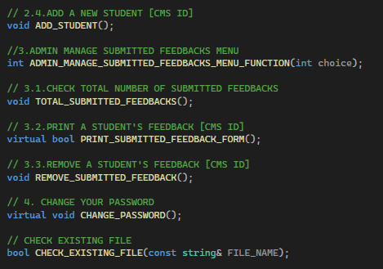
ADMIN FUNCTIONS-3

Slide 34
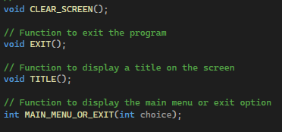
INDEPENDENT FUNCTIONS

Slide 35
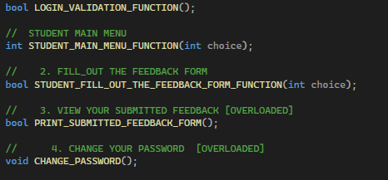
STUDENT FUNCTIONS

Slide 36
GUI
The GUI of this program is built on QT software

Slide 37
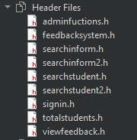
GUI HEADER FILES

Slide 38
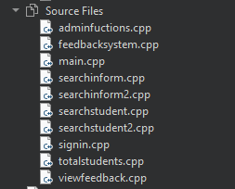
GUI CPP files

Slide 39
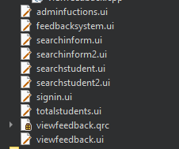
GUI UI FILES

Slide 40
DEMO:

Slide 41
THE END!

